Slide 1
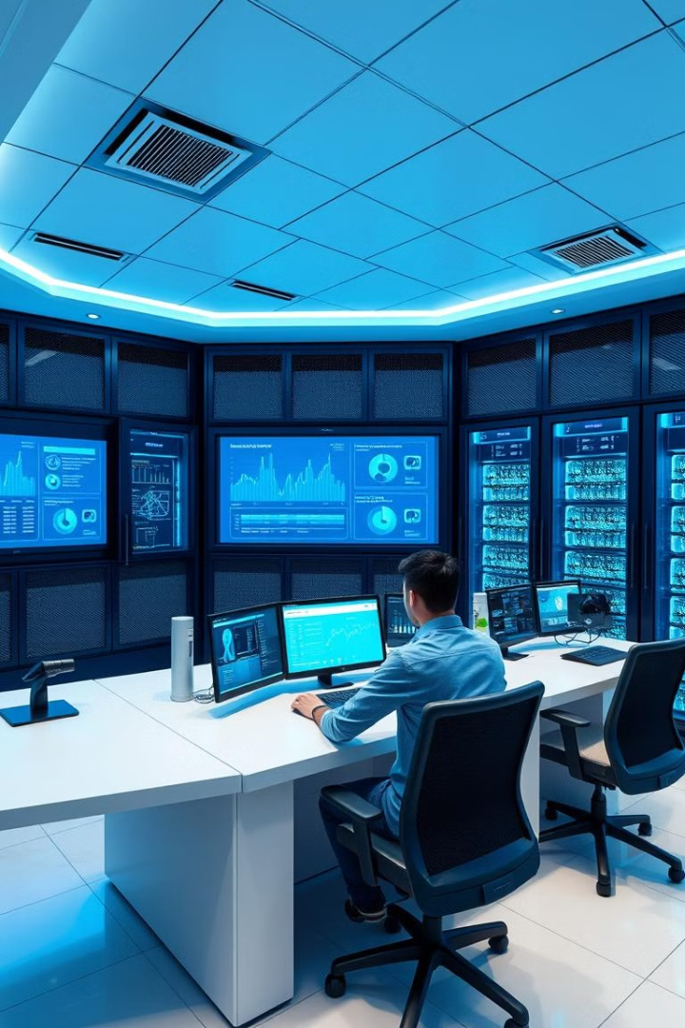


Splunk Alerting and Reporting for Real-Time IT Monitoring
Discover how Splunk revolutionizes IT operations, security, and business intelligence with real-time data analytics. Splunk is used by over 90 of the Fortune 100 companies.
by Trupthi Shetty

Slide 2
Core Concepts: Understanding Splunk Alerts
Splunk alerts notify users of critical events. Types include scheduled, real-time, and triggered. Alert actions can be email notifications or script executions.
Scheduled Alerts
Real-time Alerts
Triggered Alerts
Run at predefined intervals.
Trigger instantly upon event detection.
Activate based on specific conditions.

Slide 3
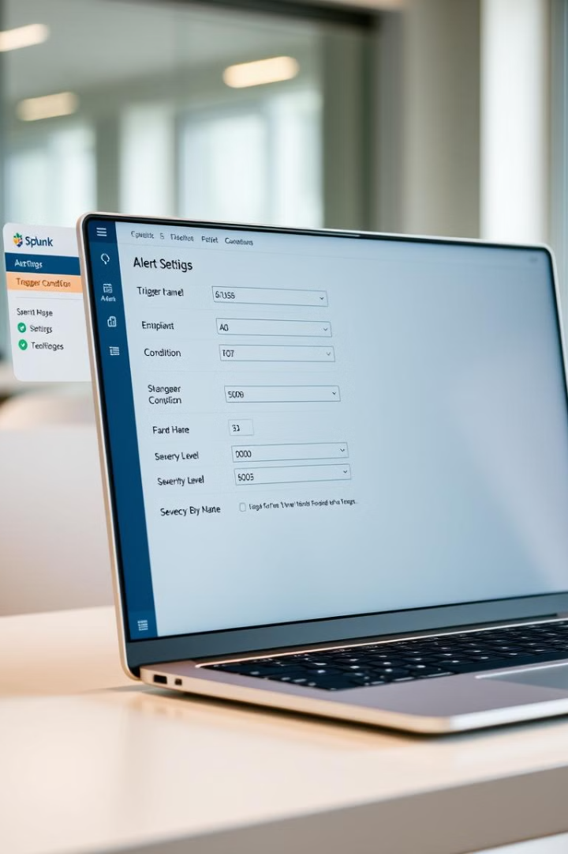




Configuring Splunk Alerts: A Step-by-Step Guide
Create Splunk alerts via the GUI. Configure search queries, trigger conditions, and throttle settings. Efficient queries reduce alert fatigue by 25%.
Define Query
Write the search query.
Set Conditions
Specify trigger conditions.
Throttle
Implement throttle settings.
Define Actions
Configure alert actions.

Slide 4




Real-Time IT Example 1: Security Breach Detection
Detect suspicious logins from multiple locations. Alerts notify the security team immediately. Security breaches cost companies an average of $4.45 million.
Identify Threat
Instant Alert
Secure System
Query for unusual activity.
Notify security team.
Take corrective action.

Slide 5
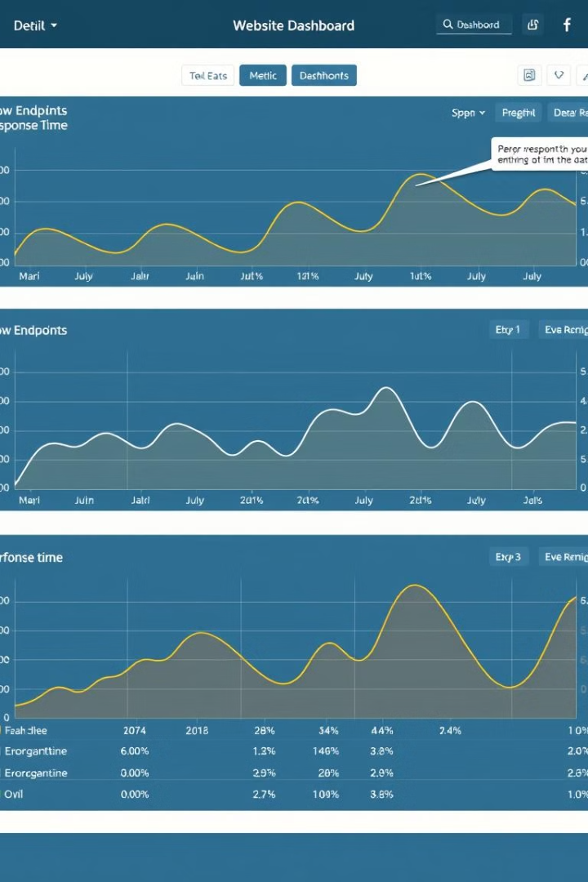
Real-Time IT Example 2: Application Performance Monitoring
Monitor website response times to detect performance degradation. Alerts notify operations when response times exceed a threshold. 40% of users abandon slow sites.
1
Track Response
2
Identify Slow Spots
Monitor website response times.
Find performance bottlenecks.
3
Alert Operations
Notify team of issues.

Slide 6



Core Concepts: Understanding Splunk Reporting
Splunk reports improve data visibility and decision-making. Types include scheduled, summary, and dashboards. Customize report formatting for clarity.
2
Summary Reports
1
Schedule Reports
Dashboards
3

Slide 7
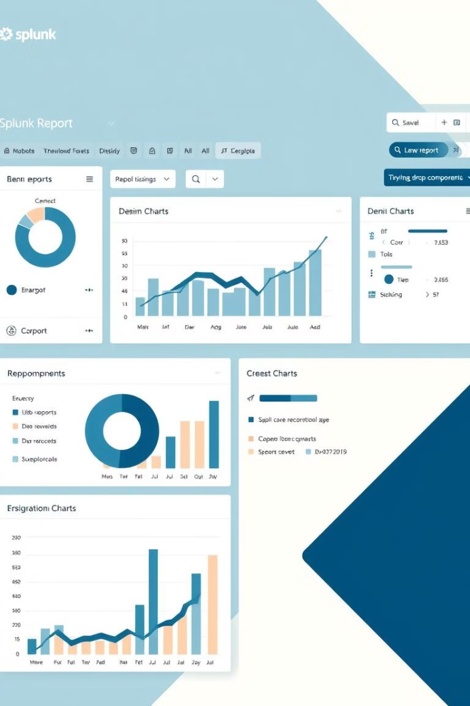
Creating Splunk Reports: A Practical Demonstration
Create Splunk reports via the GUI. Configure search queries, time ranges, and visualizations. Dashboards for executives, scheduled reports for detail.
Search Query
Time Range
Define your search criteria.
Set the period for analysis.
Visualization
Choose chart types wisely.

Slide 8
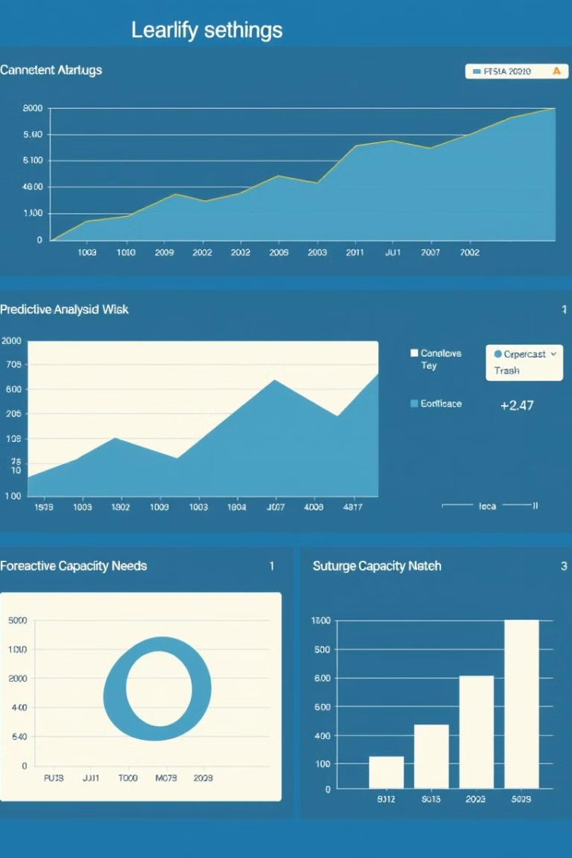
Real-Time IT Example 3: Capacity Planning and Resource Utilization
Monitor disk space and predict future capacity. Visualize trends to identify bottlenecks. Optimize capacity planning by 15% with predictive reports.
1
Track Usage
Monitor disk space utilization.
2
Predict Needs
Forecast capacity requirements.
3
Visualize Trends
Identify bottlenecks early.

Slide 9
Best Practices for Splunk Alerting and Reporting
Throttle alerts and filter noise. Use meaningful names. Regularly review effectiveness. Document configurations. Centralize management for better control.
Reduce Noise
Clear Names
Regular Reviews
Implement throttling.
Use descriptive titles.
Ensure effectiveness.

Slide 10

Resources and Further Learning
Explore Splunk documentation, community forums, and apps like Enterprise Security and ITSI. Splunkbase offers pre-built apps. Splunkbase for apps.
Splunk Docs
Community
Enterprise Security
Official resources.
Forums and groups.
Advanced analytics.

